Slide 1


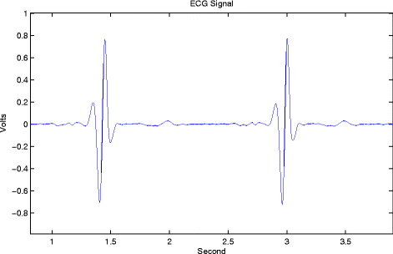
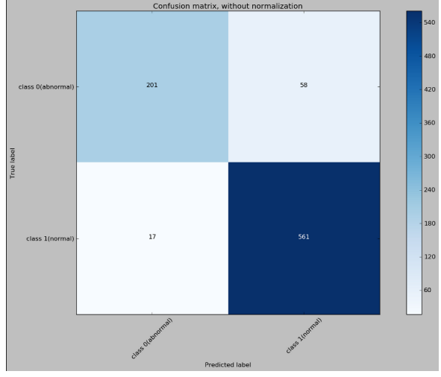
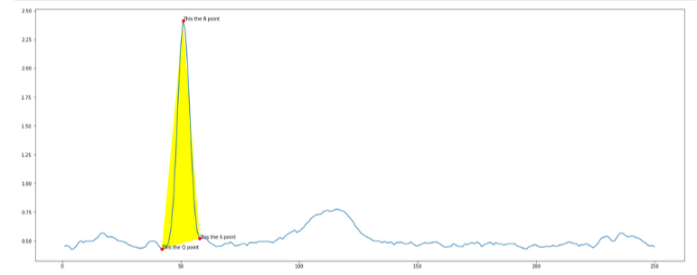
Statistical analysis of ECG signal for myocardial ischaemia
Name | Roll Number
Madhurima Purkait | GCECTB-R17-3013
Pratyusha Sinha | GCECTB-R17-3015
Subrata Sarkar | GCECGB-R17-3035
Sneha Tiwari | GCECTB-R17-3041

Slide 2
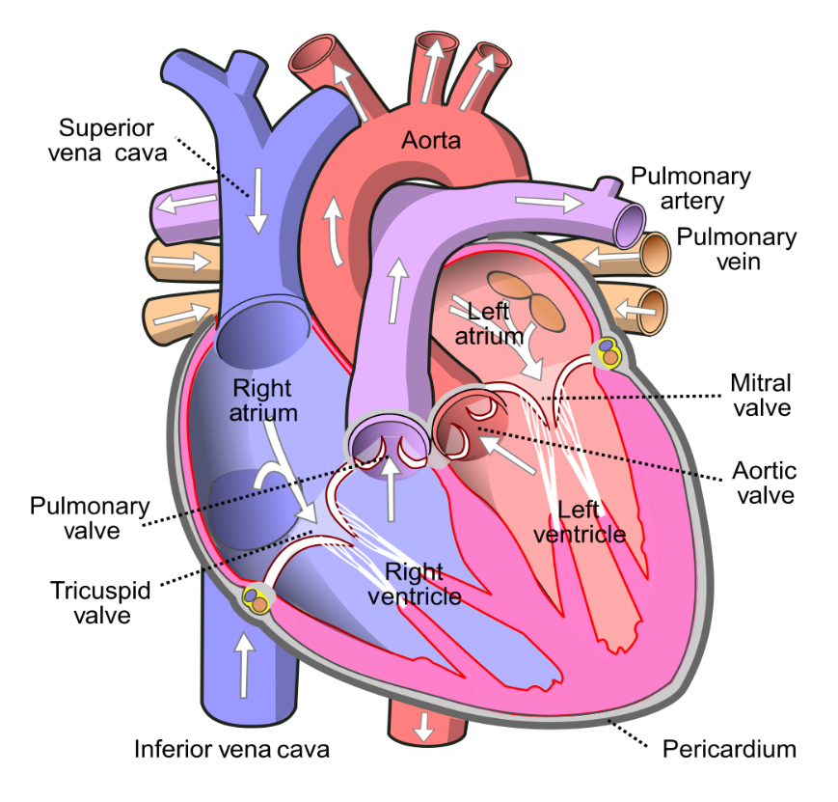
Introduction:
The human heart is an organ that pumps blood throughout the body via the circulatory system, supplying oxygen and nutrients to the tissues and removing carbon dioxide and other wastes.
Anatomy of Human heart

Slide 3
Electrocardiogram (ECG):
Our nerve and muscle cells communicate with each other using electrical and chemical signals. Regular electrical signals also control our heartbeat. These signals are sent by a group of cells in the right atrium of the heart known as the sinoatrial node (SA node), and they spread through the heart muscle tissue as tiny electrical impulses.
This causes first the atria and then the ventricles of the heart to contract. The way that these signals spread through the heart can also be measured on the surface of our skin. It mainly records how often the heart beats (heart rate) and how regularly it beats (heart rhythm).
ECG a non-invasive method of measuring the heart’s electrical activity during the cardiac cycle.
An ECG measures these changes in electrical signals (or, in fact, voltage) on different areas of skin and plots them as a graph. The resulting ECG graph is called an electrocardiogram.
What does an ECG measure?
A single round of the cardiac cycle shows up in 3 main “waves” on an ECG—the P wave, the QRS complex, and the T wave. These waves reflect the activities of the heart’s electrical conduction system, which is composed of specialized muscle fibres.

Slide 4
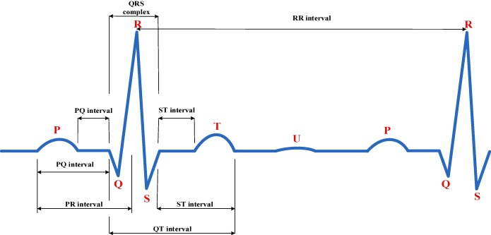
A Normal ECG Signal
12 Lead ECG:
The standard ECG has 12 leads. Six of the leads are considered “limb leads” because they are placed on the arms and/or legs of the individual. The other six leads are considered “precordial leads” because they are placed on the torso (precordium).
The six limb leads are called lead I, II, III, aVL, aVR and aVF. The letter “a” stands for “augmented,” as these leads are calculated as a combination of leads I, II and III.
The six precordial leads are called leads V1, V2, V3, V4, V5 and V6.

Slide 5
The results of a 12-lead ECG show:
The 12-lead ECG takes advantage of the fact that signals sent by the heart don't travel evenly over the skin. The device compares the strength of the signals between two electrodes called “leads.”
For example, one of the leads is measured based on the two electrodes on your arms. A 12-lead ECG, as its name implies, is used to measure twelve leads. Depending on which lead shows irregularities, experts can find out things like in which part of the heart muscle an infarction has occurred, or whether a heart rhythm problem is coming from the left or right ventricle.

Slide 6
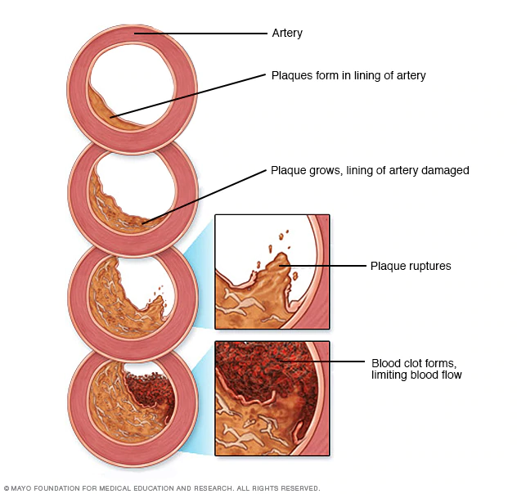
Myocardial ischemia
Myocardial ischemia occurs when blood flow to the heart is reduced, preventing the heart muscle from receiving enough oxygen. The reduced blood flow is usually the result of a partial or complete blockage of the heart's arteries (coronary arteries).
Myocardial ischemia, also called cardiac ischemia, reduces the heart muscle's ability to pump blood. A sudden, severe blockage of one of the heart's artery can lead to a heart attack. Myocardial ischemia might also cause serious abnormal heart rhythms.
Symptoms:
Some people who have myocardial ischemia don't have any signs or symptoms (silent ischemia).
Signs and symptoms which might be experienced :
chest pressure or pain(typically on the left side of the body)
A fast heartbeat
Shortness of breath when you are physically active
Nausea and vomiting
Sweating
Causes: Conditions that can cause myocardial ischemia include:
Coronary artery disease (atherosclerosis). Plaques made up mostly of cholesterol build up on your artery walls and restrict blood flow.
Blood clot. The plaques that develop in atherosclerosis can rupture, causing a blood clot.
Coronary artery spasm(Uncommon Cause). This temporary tightening of the muscles in the artery wall can briefly decrease or even prevent blood flow to part of the heart muscle.

Slide 7
Chest pain associated with myocardial ischemia can be triggered by:
1.Physical exertion 2.Emotional stress 3.Cold temperatures 4.Cocaine use 5.Eating a heavy or large meal
6.Sexual intercourse
Risk factors:
1.Tobacco 2.Diabetes 3.High blood pressure 4.High blood cholesterol level 5.High blood triglyceride level 6.Obesity Waist circumference 7.Lack of physical activity
Complications:
Heart attack
Irregular heart rhythm (arrhythmia)
Heart failure
Detection:
Myocardial Ischemia changes in ECG are:
ST segment elevation or depression.
T wave inversion
Appearance of wide deep Q waves.

Slide 8
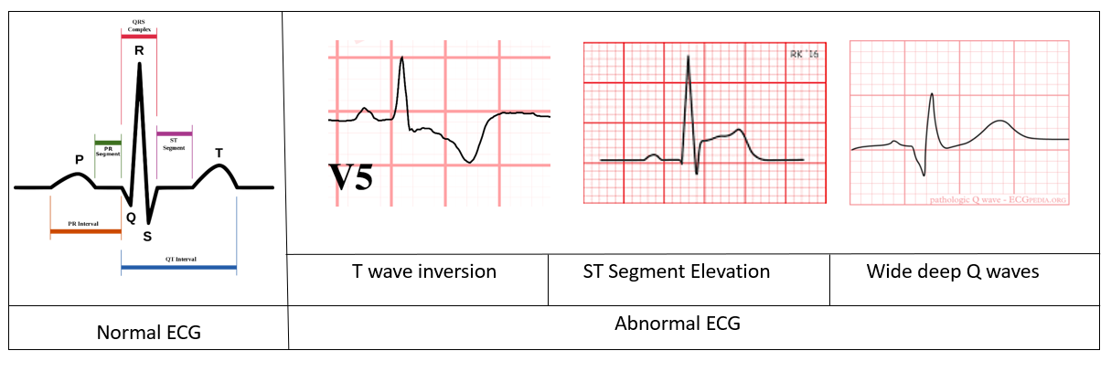
Treatment:
Treatment for myocardial ischemia involves improving blood flow to the heart muscle. Treatment may include medications, a procedure to open blocked arteries (angioplasty) or bypass surgery.

Slide 9
Previous Work
https://www.banglajol.info/index.php/BJMP/article/download/39147/26626
They used ST slope for classification of ECG segments
https://link.springer.com/article/10.1007/s10489-018-1179-1
They took images of ECG signal and fed it to a CNN and predicted whether the segment was normal or not.

Slide 10
Myocardial Ischemia Detection from Slope of ECG ST Segment
Our main aim is to develop a program/code to detect myocardial ischemia with the help of ECG report,which would be computationally less complex and easy to implement in homecare ECG devices.
It has been observed that for the normal case, the ST segment(in pqrs complex)is at approximately the same level as the isoelectric line. However, it is found that for ischemia, the ST segments are clearly elevated with respect to the isoelectric level .
We found out in the paper published by University of Dhaka that ST slope can be used for classification of ECG wave segment and then use the slope data as condition for the classification
So, the proposed method measures slope of ST segment which must vary in case of ST changes.
We are using the European ST-T database which contains ECG signals with ST segment and T wave changes (Taddei, et al., 1992). The database contains ECG signals from ischemic patients where normal ECG sections and sudden ischemic episodes are annotated.

Slide 11
ST segmentation
The duration of ST segment is usually 120ms.
The ECG signals used have a sampling frequency of 250 Hz. So the length equals to approximately 30 samples.
Experimentally it is observed that the ST segment starts at about 15 samples after the R peak. So the 30 samples of ST segment is extracted accordingly.

Slide 12
Our proposed solution in 6th sem
We want to analyze the ECG data to provide a prediction about the ECG whether the patient has myocardial ischaemia. In order to do that we need to perform statistical analysis of the ECG signals for different paitents
We have built functions to find slope for various segments in the slices of the ECG. We not only measure the slope but also the angle made by the R peak and the amplitude of the R peak
Two methods of prediction that we have in our consideration are ,one using the QRS angle and the other to use a 1d convolutional neural network to classify the ECG

Slide 13
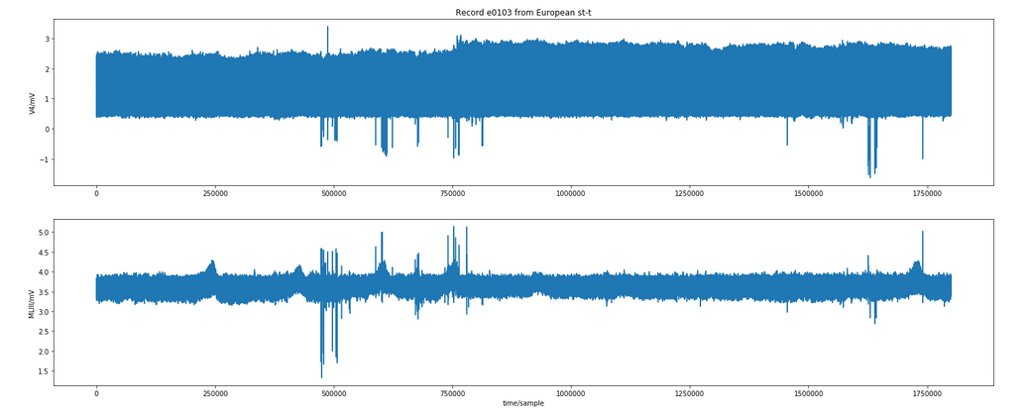
Sample ECG from dataset

Slide 14
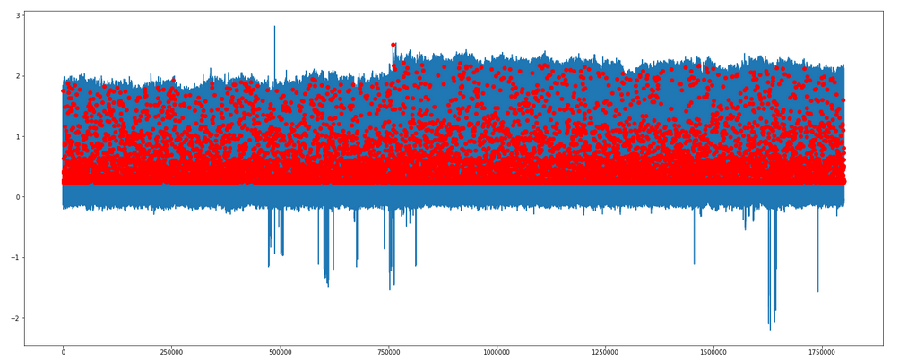
R peak detection using max by slicing every 200 points

Slide 15
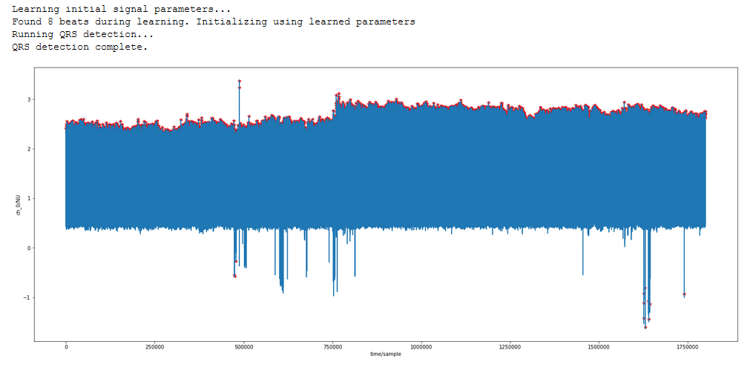
R peak detection using XQRS algorithm

Slide 16
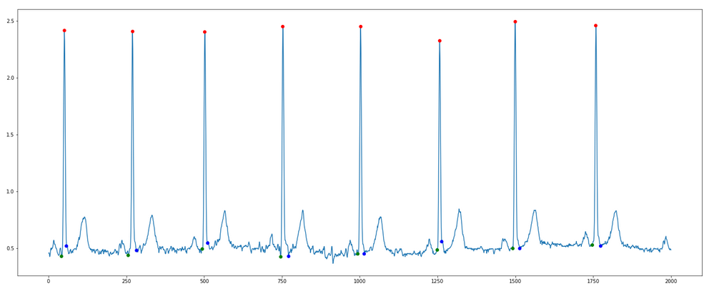
QRS segment detection

Slide 17
Work done till 7th semester
We have so far built functions which takes slice of ECG with 8 R-peaks as input and detects the R-peaks using XQRS detection provided with wfdb module.
First we tried to detect the R-peaks by slicing the ECG using the fact that on average a single heart beat takes 0.8 sec and finding the max voltage in the slice, but we found the method to fail incase the R-peak was not present in the slice so we switched to XQRS algorithm.
We found out that in our dataset that the S-T segment lied between the R peak+15 time slice and R peak+45 time slice. Also Q and S point detection was easy as we needed to find the point of deflection to the left and right of the R peak respectively

Slide 18
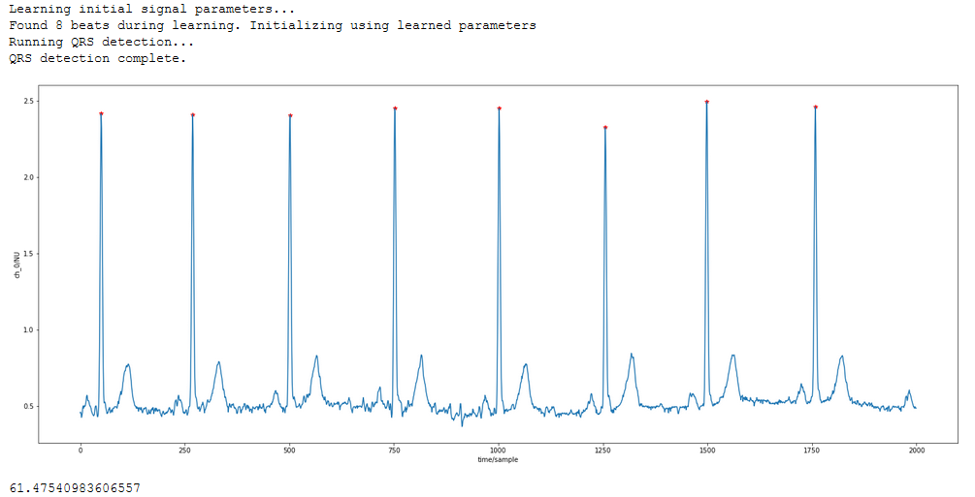
R peak detection using XQRS small slice

Slide 19
Algorithm for ST segment detection in our project
Step1: Start
Step 2: Locate the R Peak.
Step 3: Find the point of deflection of slope to the right
Step 4: Find the next point of deflection of slope to the right
Step 5: Save these sample as ST segment.
Step 6: End

Slide 20
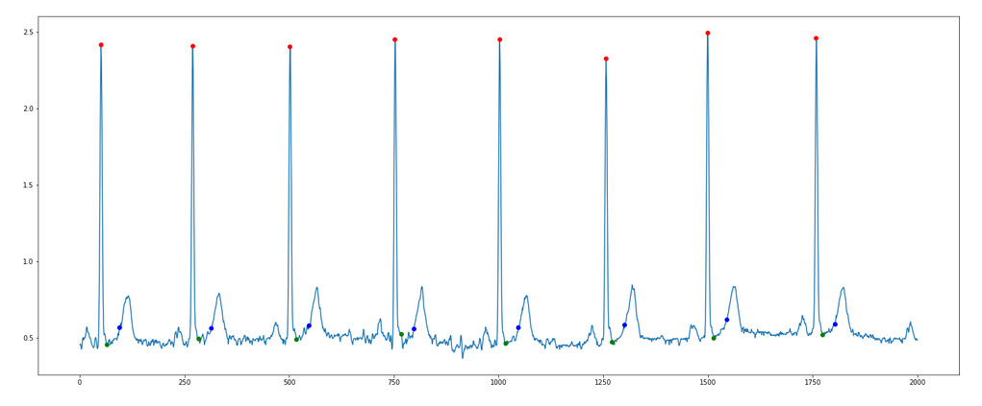
ST segment detection

Slide 21
How we can proceed further from this step
We found out in the paper published by University of Dhaka that they used ST slope for primary classification. So obviously we can use QRS angle as a secondary source of classification as we gathered from analyzing the data
We also found out that instead of using the images of ECG we can also use 1d Convolutional Neural Network to feed the raw series and perform classification. (Source: https://www.sciencedirect.com/science/article/pii/S2352914818301333). We intend to develop our own CNN model and perform classification
Then we want to implement the model as a software which doctors and techicians can use in real world.

Slide 22
Detailed description of labelling the data
Q and S point detection was easy as we needed to find the point of deflection to the left and right of the R peak respectively.
Inspired by the S-T slope classification of ECG signal, with the suggestion and the guidance of our faculty(Mr. Bimal Pal), we calculated the QRS angle and observed the value of the angle madeby QRS for both classes of data, with the help of which we wished to find out any abnormality in the ECG waveforms if the value of QRS angle differentiates from a particular range. Also, we have used only V4 lead data.

Slide 23

Labelling of data for CNN
We took four European-st-t-database records, e0103,e0104,e0105 and e0108 respectively.
In each data set we run a code where the dataset is divided into segments having 240 data point each(a typical heart rate has 70 to 75 beats per minute, i.e. each cardiac cycle takes about 0.8 seconds to complete the cycle).
During each interval, a pqrst wave is present of that particular interval and thereafter we label our data according to the shape of the graph.
We label the data as 0 when the shape of the graph matches with the general shape of pqrst wave and 1 when it matches myocardial iscaemia characteristic.
And the data recorded in csv file.
After performing the same on each of four records , we got 2891 normal and 1294 abnormal pqrst segments.

Slide 24

Measuring the angle value of r peak of abnormal segments.
After labelling the datasets, we decide to calculate the angle and amplitude of the peak of segments having r peak and store the value in csv file.
In the given figure, we calculated the angle value of normal pqrst waves.
In row 6, we can see that the r peak value is 0, when the peak is too low as compared to others. In such condition, we place value of angle as -1.
The normal value range of r peak is found to be between 56-59.
If the value of angle is greater than 59 and less than 56, then the particular qrst wave is found to be an abnormal ECG segment.

Slide 25
1D CNN model
ECG abmormality recognition is the problem of classifying sequences of ECG data recorded by ECG recording device as electrical impulses.
Classical approaches to the problem involve hand crafting features from the time series data based on fixed-sized windows and training machine learning models, such as ensembles of decision trees. The difficulty is that this feature engineering requires deep expertise in the field.
Recently, deep learning methods such as recurrent neural networks and one-dimensional convolutional neural networks, or CNNs, have been shown to provide state-of-the-art results on challenging activity recognition tasks with little or no data feature engineering, instead using feature learning on raw data.
So we developed one-dimensional convolutional neural networks for time series classification on the problem of ECG abnormality recognition

Slide 26
Architecture of the custom model we developed

Slide 27
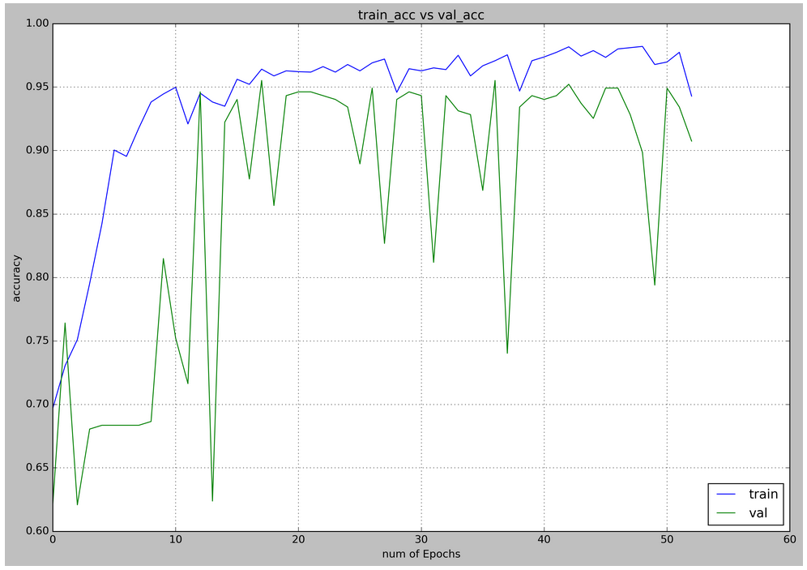
Model train accuracy curve

Slide 28
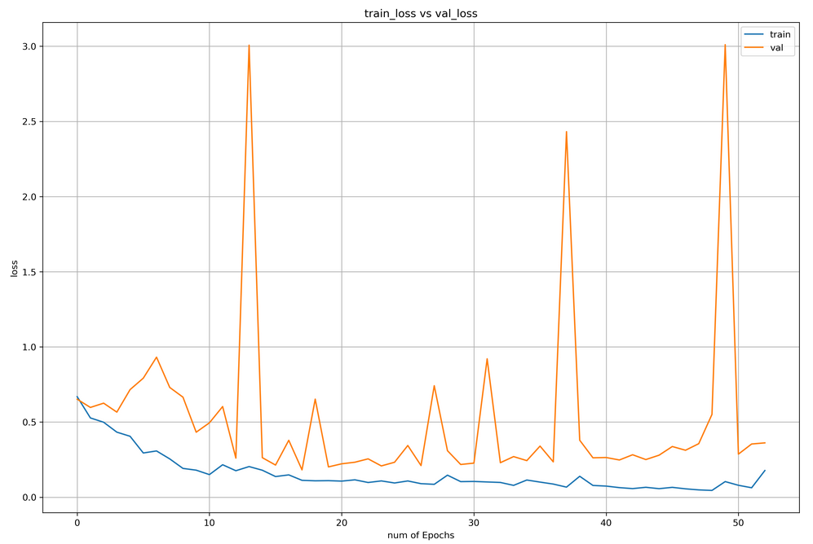
Model train loss curve

Slide 29
Metrics of the model on test data
The dataset has total 4185 samples of ECG and the train:validation:test is split as 0.7:0.1:0.2
Confusion matrix, without normalization:
abnormal [201 58]
normal [ 17 567]
abnornal normal
Measure | Value | Derivations
Sensitivity | 0.7761 | TPR = TP / (TP + FN)
Specificity | 0.9706 | SPC = TN / (FP + TN)
Precision | 0.9220 | PPV = TP / (TP + FP)
Negative Predictive Value | 0.9063 | NPV = TN / (TN + FN)
False Positive Rate | 0.0294 | FPR = FP / (FP + TN)
False Discovery Rate | 0.0780 | FDR = FP / (FP + TP)
False Negative Rate | 0.2239 | FNR = FN / (FN + TP)
Accuracy | 0.9104 | ACC = (TP + TN) / (P + N)
F1 Score | 0.8428 | F1 = 2TP / (2TP + FP + FN)
Matthews Correlation Coefficient | 0.7864 | TP*TN - FP*FN / sqrt((TP+FP)*(TP+FN)*(TN+FP)*(TN+FN))

Slide 30
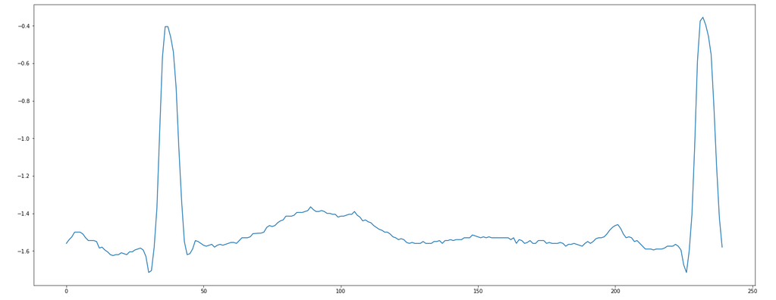
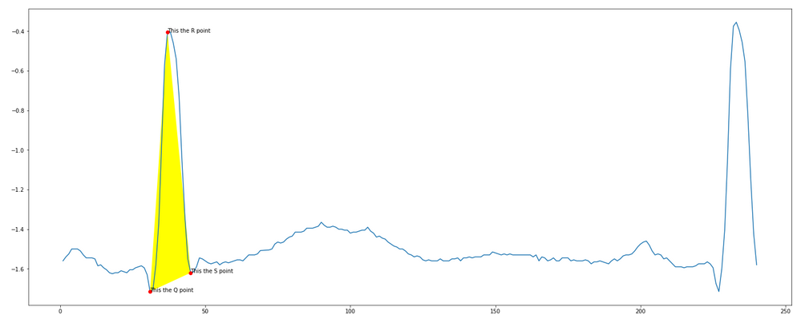
Test with individual manual input
On the left we have a abnormal ECG where the S point is high and also the st segment is flattened.
Real result: class 1(abnormal) predicted: class 1(abnormal)
QRS angle: 69.55degree

Slide 31
Future Scope
Better accuracy – These model is based on extensive samples and trained by datas fed to it. More number of samples will improve the efficiency and accuracy of the model. There is always scope for improvement.
Better explainability using QRS angles – While using this CNN model, 1D array of data points are fed as input. The CNN is like a black box giving prediction on the fed ECG signal which lacks explainability from medical point of view. That is why value of QRS angle again serves a purpose. Value of QRS angle can be associated with the output of CNN model to explain the reports much better as the pattern of QRS angle is easily visible in the waveform which we have done. We can include other metrics like ST segment slope to classification
Better training data by validating the training data with the help of professionals – While labelling the particular part of waveforms, incorrect labelling may have happened and that can effect the efficiency of the model as we are mot medical professionals and the waveforms are primalrily manually labelled by observing the patterns. So if that can be done with the help of professionals, the probability of wrong labelling can be reduced to much greater extent which will surely be better training data.Eventually that will improve the accuracy of the model .

Slide 32
Thank You!

